Slide 1


Authoring ArcGIS StoryMaps Using API for Python
ESRI DEVELOPER SUMMIT 2023
Nanae Aubry
John Yaist

Slide 2

Slides and Notebooks – will be available!
After the Event!
Esri Proceedings site - Slides
ArcGIS API for Python Public Repo – Notebooks
https://github.com/Esri/arcgis-python-api
On the conference_talks branch in the talks directory

Slide 3
Agenda
Target Audience
ArcGIS StoryMaps - What are they?
Demos:
Authoring
Editing

Slide 4

Target Audience
We are making some assumptions:
Proficient in interacting with the ArcGIS Web GIS platform
Experience with creating and/or consuming ArcGIS StoryMaps
2013 – 2019 – Esri Classic Story Maps
2019 – present – ArcGIS StoryMaps
Cursory knowledge of Python programming
Exposure to the API for Python

Slide 5
Resources: What is ArcGIS StoryMaps?
ESRI DEVELOPER SUMMIT 2023
Web-based application for sharing maps in a narrative multimedia format

Slide 6
Why ArcGIS StoryMaps?
The ArcGIS StoryMap Advantage
Story builder – single authoring interface
Enhanced map and scene support – configure items without leaving builder
Express maps – lightweight objects to provide geographic context
Themes – one-click adjustments
Optimizations – designed for visualization on both desktop and mobile devices

Slide 7

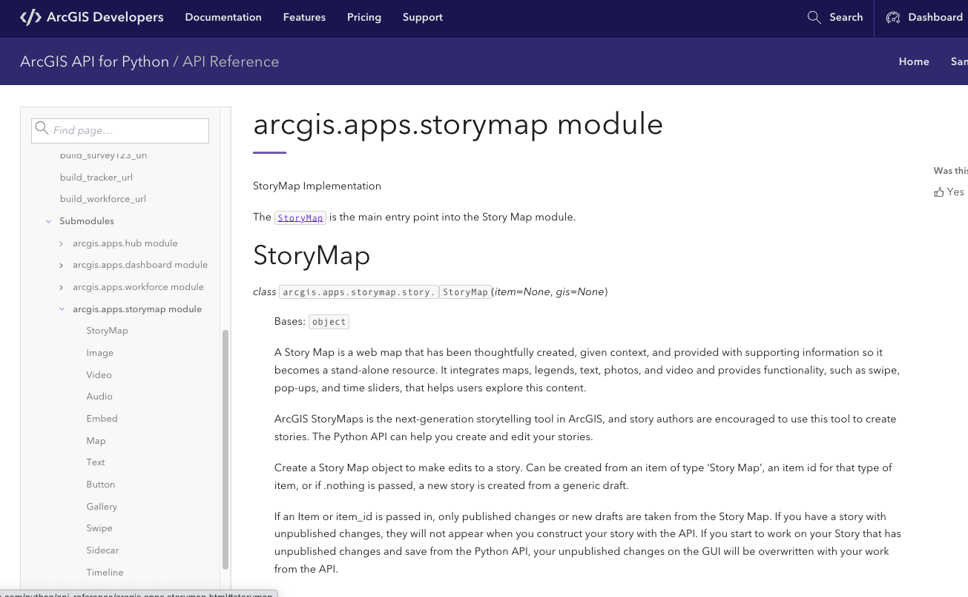
The API Reference
https://developers.arcgis.com/python/api-reference/arcgis.apps.storymap.html#storymap

Slide 8


Authoring a StoryMap
John Yaist

Slide 9
Editing a StoryMap
Nanae Aubry

Slide 10




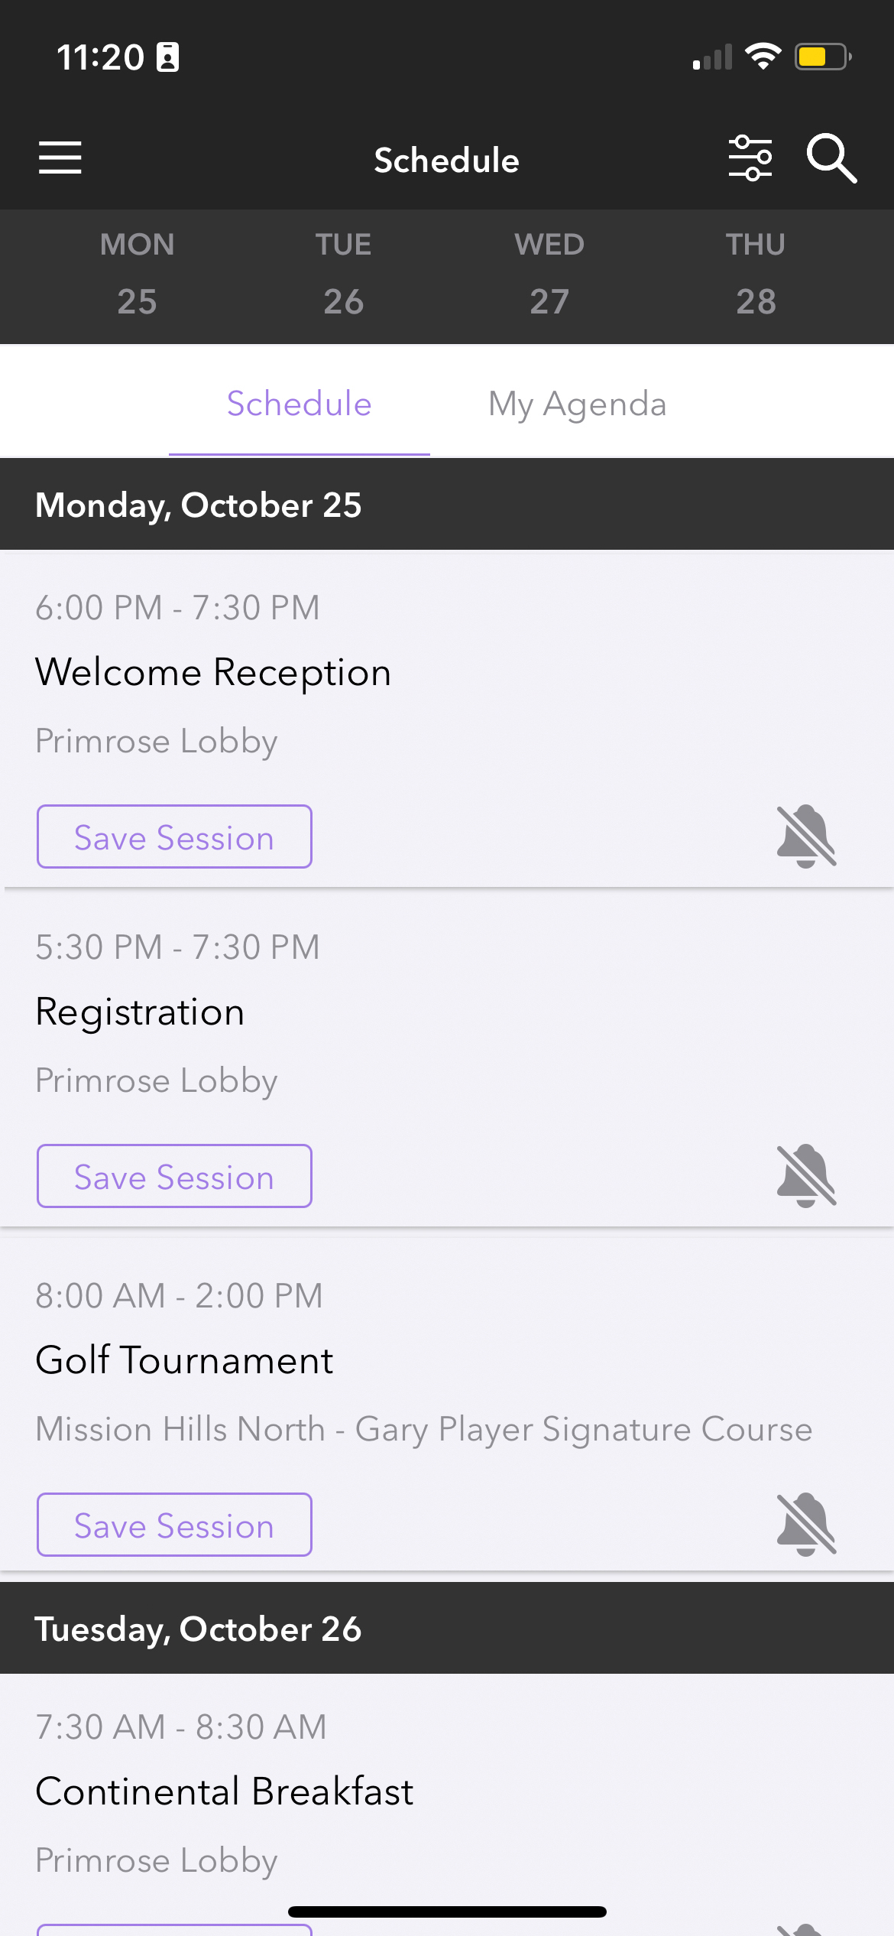
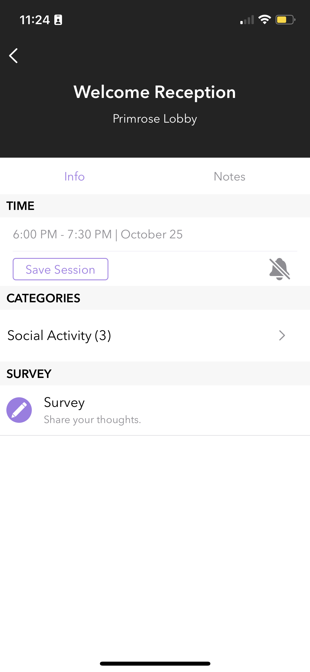
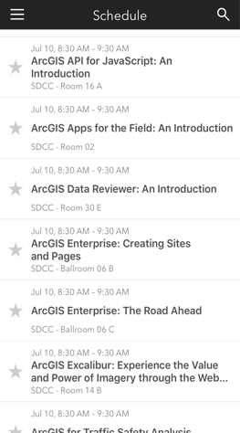
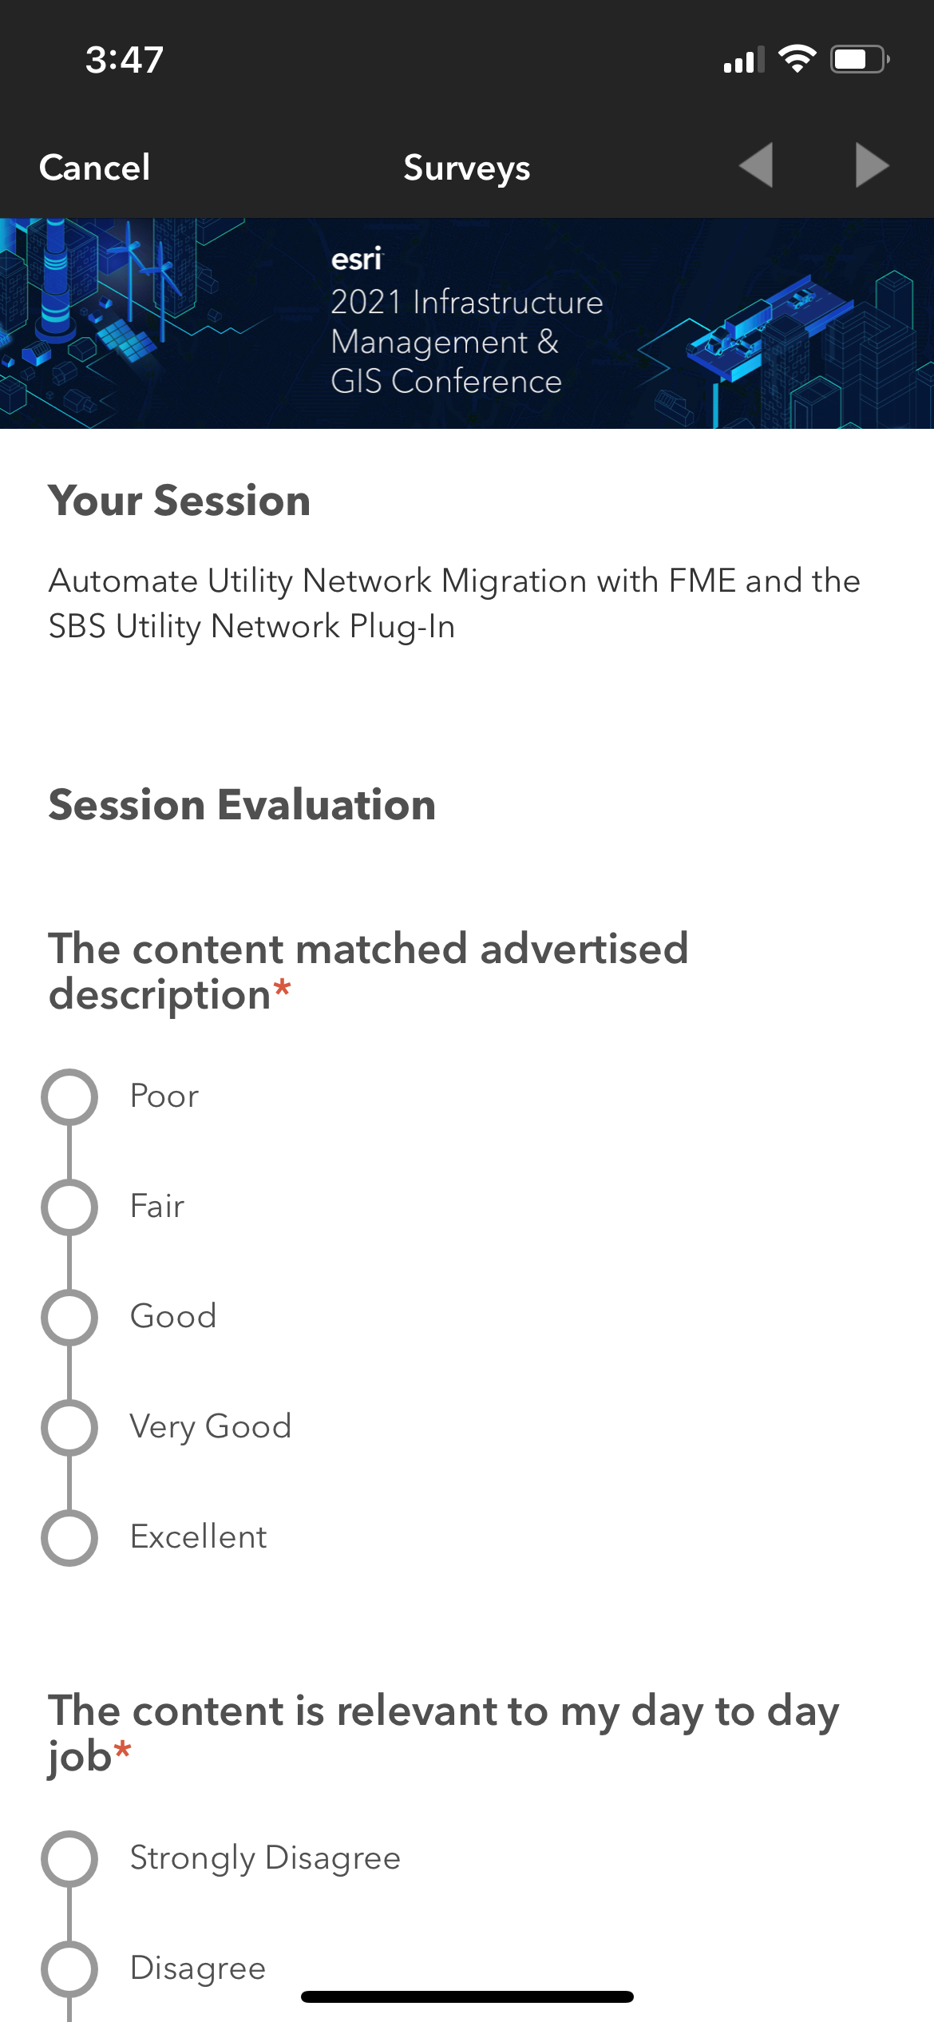
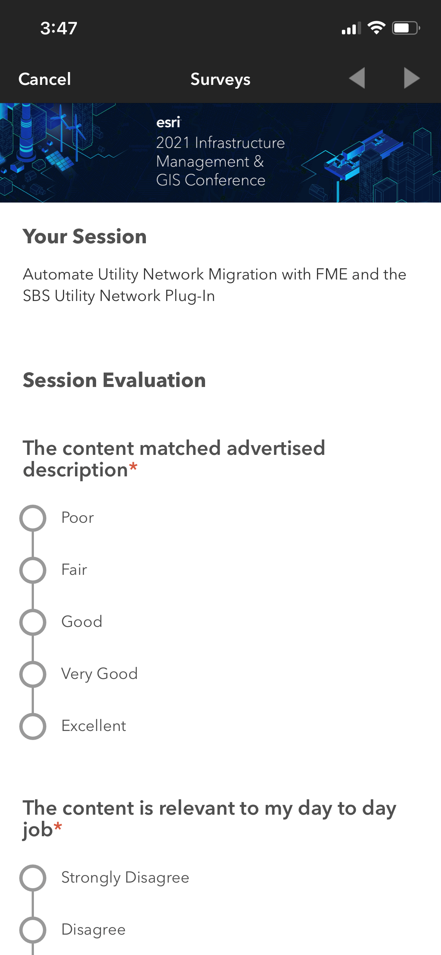
Please Share Your Feedback in the App
Download the Esri Events app and find your event
Select the session you attended
Scroll down to “Survey”
Log in to access the survey

Slide 11

Copyright © 2022 Esri. All rights reserved.

